Slide 1
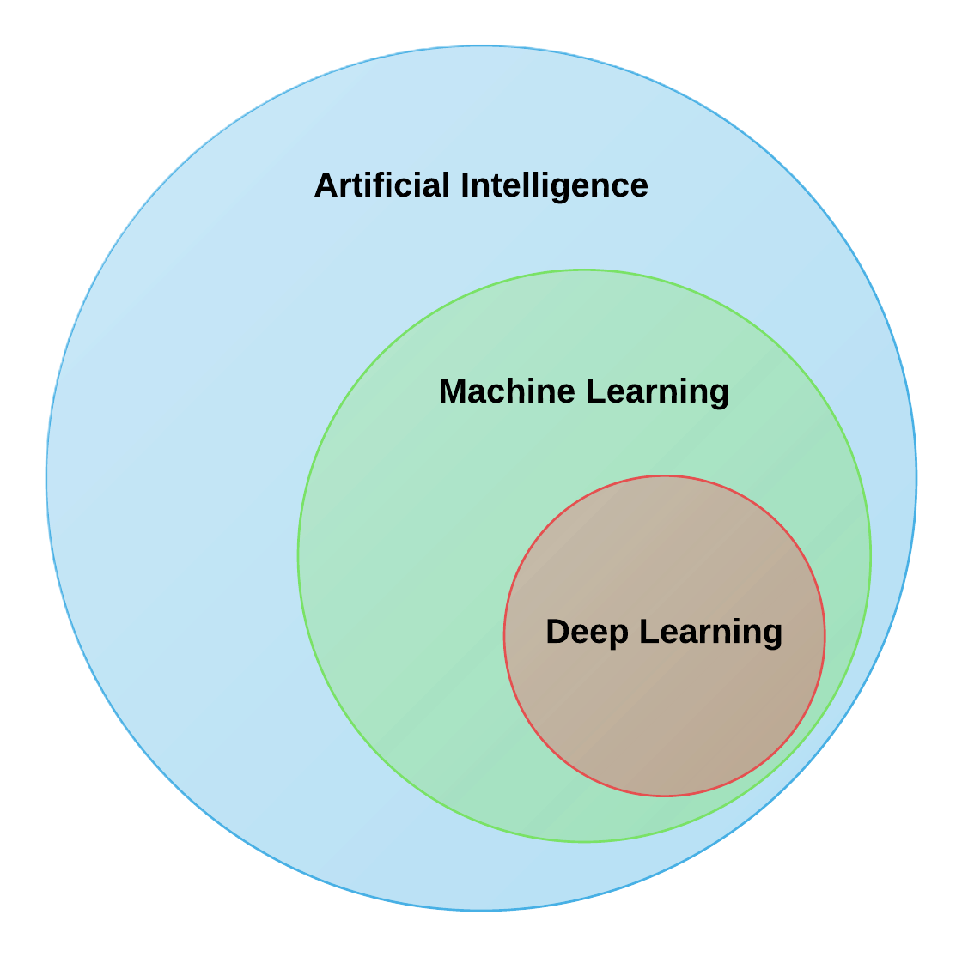
Concept of AI/ML
Artificial Intelligence is the idea that machines (or computers) can be built that has intelligence parallel (or greater) to that of a human, giving them capability to perform tasks that requires human intelligence to perform.
Machine Learning is a subset of Artificial Intelligence which aims at providing machines with the ability to learn without explicitly programming. The idea is that such machines (or computer programs) once built will be able to evolve and adapt when they are exposed to new data.
Deep Learning is a subset of Machine Learning which focuses on an area of algorithms which was inspired by our understanding of how the brain works in order to obtain knowledge. It’s also referred to as Deep Structured Learning or Hierarchical Learning.

Slide 2
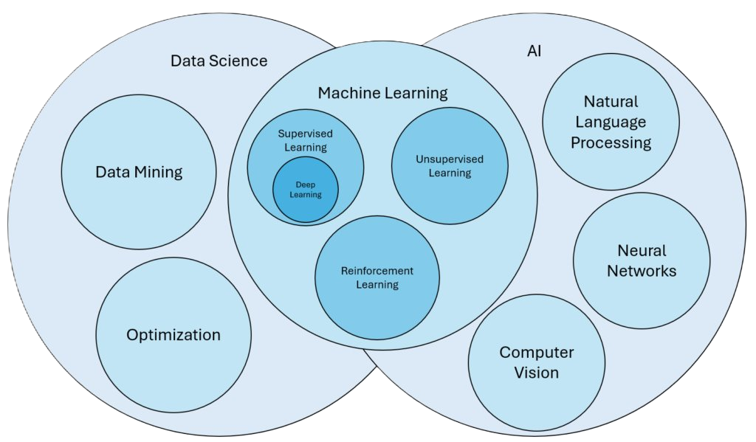
Artificial Intelligence
Artificial Intelligence (AI) refers to the simulation of human intelligence in machines that are programmed to think, learn, and problem-solve. The goal of AI is to create systems that can perform tasks typically requiring human intelligence, such as recognizing patterns, making decisions, understanding natural language, and improving over time through experience. The three major components of AI are:
Machine Learning (ML)
Natural Language Processing (NLP)
Computer Vision

Slide 3
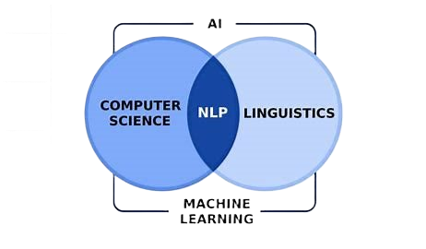
Natural Language Processing (NLP)
Understanding and processing human language using techniques like tokenization, part-of-speech tagging, Named Entity Recognition (NER), sentiment analysis, machine translation, etc. The three major components of NLP most needed for data science are:
Text Preprocessing: Cleaning and transforming raw text into a structured format that can be analyzed or modeled.
Sentiment Analysis: Understanding the sentiment or emotion behind a piece of text, often used for customer feedback analysis, reviews, and social media monitoring.
Text Classification: Categorizing text into predefined labels or classes, useful in applications like spam detection, topic categorization, and content filtering.

Slide 4
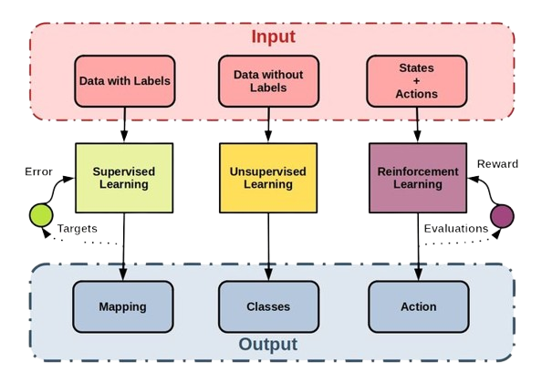
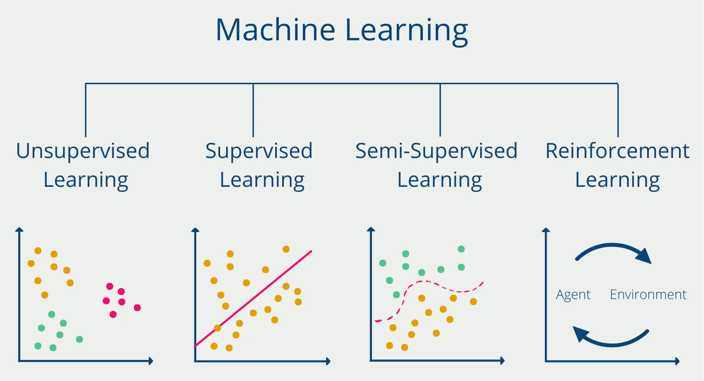
MACHINE LEARNING
Machine learning is a method of data analysis that automates analytical model building.
Using algorithms that iteratively learn from data, machine learning allows computers to find hidden insights without being explicitly programmed where to look.

Slide 5
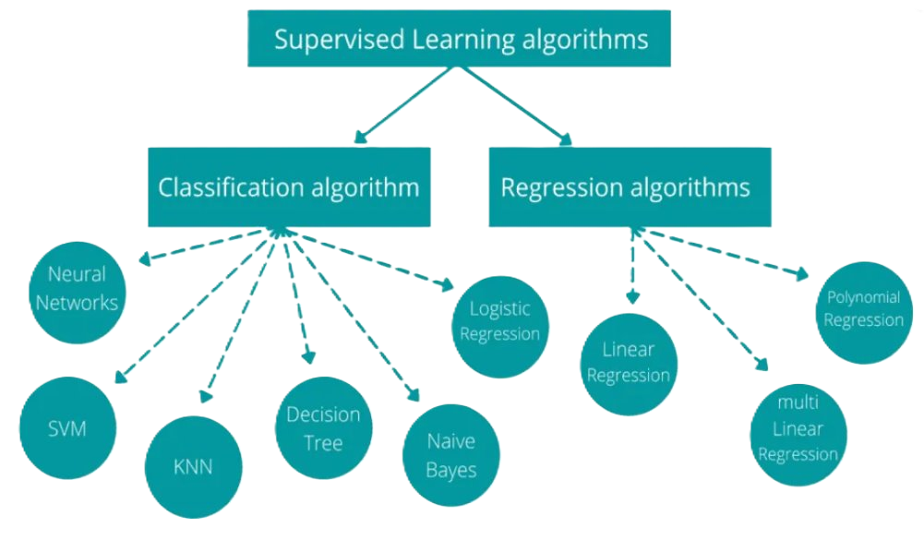
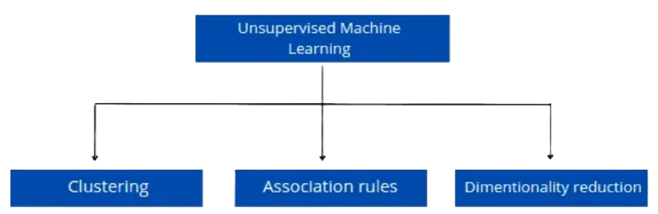
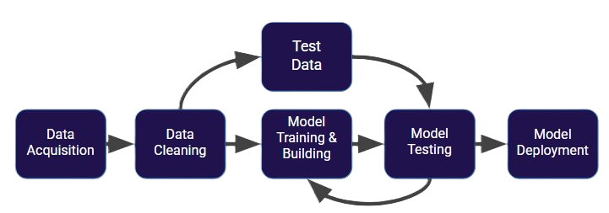
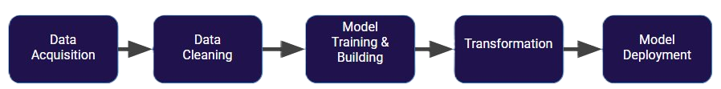
Different Types of Algorithm for SL , USL in ML:
Supervised learning is a type of machine learning algorithms that learns from labeled data. Labeled data is data that has been tagged with a correct answer or classification.
In Unsupervised learning, the machine is trained on a set of unlabeled data, which means that the input data is not paired with the desired output. The machine then learns to find patterns and relationships in the data.

Slide 6
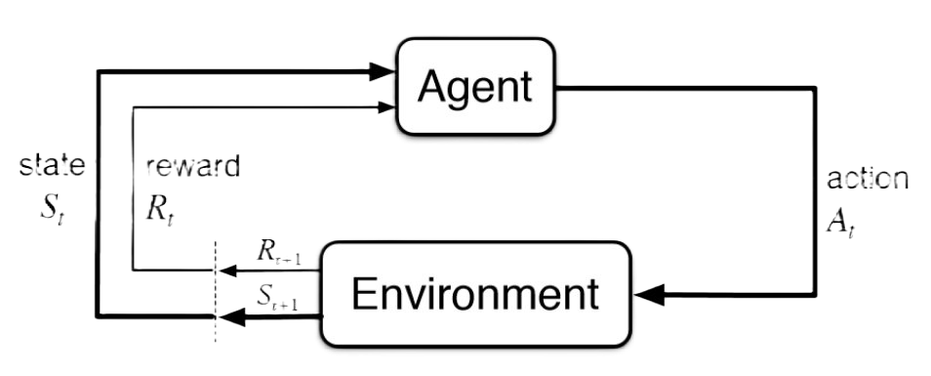
Reinforcement Learning
Types
Algorithms
Positive
Models
Negative
Markov Decision Process
Q -Learning
Value Based
Model Based
Policy Based
Reinforcement Learning:
Reinforcement Learning is defined as a Machine Learning method that is concerned with how software agents should take actions in an environment. Reinforcement Learning is a part of the deep learning method that helps you to maximize some portion of the cumulative reward.
Agent: It is an assumed entity which performs actions in an environment to gain some reward.
Environment (e): A scenario that an agent has to face.
Reward (R): An immediate return given to an agent when he or she performs specific action or task.
State (s): State refers to the current situation returned by the environment.

Slide 7
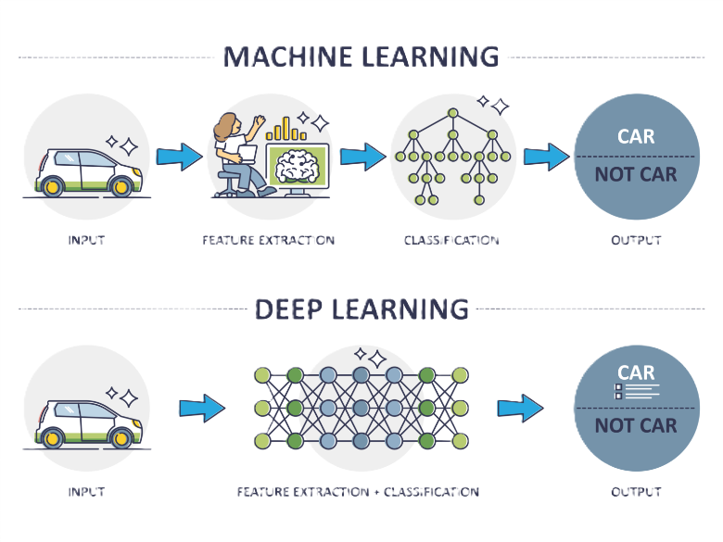
Deep Learning
Deep learning is preferred when:
Working with large, complex, and unstructured data (images, text, audio).
Automating feature extraction is necessary.
Tackling high-complexity problems that require deep hierarchical models.
Improving performance in areas like computer vision, NLP, and reinforcement learning.
Traditional machine learning remains valuable for simpler tasks with structured data and smaller datasets, but deep learning becomes more effective as the data grows in size and complexity.

Slide 8
Artificial Intelligence
Machine Learning
Reinforcement Learning
Supervised Learning
Q-Learning
Deep Q-Networks(DQN)
Policy Gradient Methods
Actor Crictic Methods
Prediction
Linear Regression
Classification
Logistic Regression
Support Vector Machines
K-Nearest Neighbors
Naïve Bayes
Gradient Boosting Machine
Decision Tree
Random Forest
AI
Convolutional Neural Networks(CNN)
Generative Adversarial Networks(GAN)
Autoencoders
Deep Learning
Unsupervised Learning
Signal Processing
Independent Component Analysis(ICA)
Recurrent Neural Networks (RNN)
Clustering
K-Means Clustering
NLP
Dimensionality Reduction
Principal Component Analysis(ICA)
Hierarchical Clustering
Data Visualization
T-Distributed Stochastic Neighbor Embedding(t-SNE)
Time Series
Long Short-Term Memory(LSTM)

Slide 9
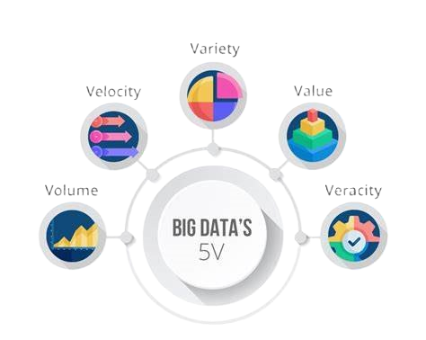
Big Data
Big Data refers to extremely large sets of data that are too complex or voluminous to be processed and analyzed using traditional data processing methods.
Big Data typically involves data that is generated at a high velocity, in diverse formats, and on a large scale.
It can come from various sources, such as social media, sensors, transactions, videos, and more.

Slide 10
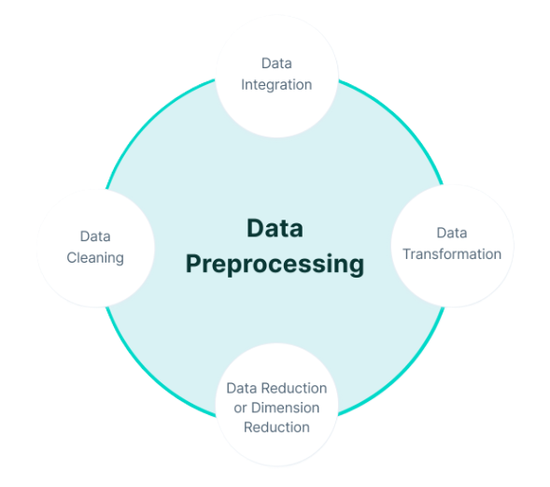
Data Preprocessing
Data preprocessing is a crucial step in the machine learning (ML) pipeline for several reasons.
The raw data that we receive is often messy, incomplete, or not in a suitable format for training a model.
Preprocessing transforms the data into a format that is cleaner, more consistent, and more suitable for machine learning algorithms to understand and work with.

Slide 11
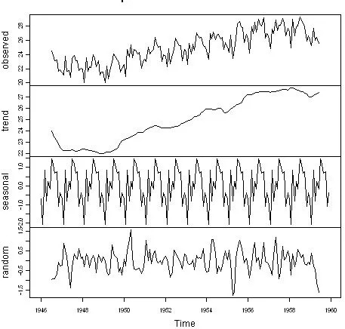
Time Series in Machine Learning
Time series data consists of observations collected at regular time intervals, such as daily stock prices, monthly sales figures, or yearly climate data.
A time series can be analyze in detail by breaking down it into its primary components . We call this process as time series decomposition . If you closely look at a time series it is composed of Trend , Seasonality, Cyclic and Residual components.
Method | Advantages | Disadvantages | When to Use
Multi-Layer Perceptron (MLP) | - Can model complex, non-linear relationships. - Flexible for different types of time series data. | - Requires careful hyperparameter tuning. - Prone to overfitting with limited data. | - When you have a sufficient amount of data. - When non-linear patterns are present in the data.
Recurrent Neural Networks (RNN) | - Suitable for sequential data. - LSTM/GRU handle long-term dependencies well. | - Computationally intensive. - Complex to design and tune. | - When temporal dependencies are critical. - For tasks involving long-term memory (e.g., LSTM, GRU).
Convolutional Neural Networks (CNN) | - Effective at capturing local patterns. - Computationally efficient due to parallel processing. | - May struggle with long-term dependencies. - Requires careful architecture design. | - When local patterns are significant. - When computational efficiency is needed.
Decision Tree-Based Models | - Handles non-linear relationships well. - Robust to overfitting with proper tuning. - Less feature engineering needed. | - Less interpretable. - Computationally intensive for large datasets. | - When feature interactions are complex. - For robust, high-performing models with less feature engineering.
Transformer Neural Networks | - Captures long-range dependencies effectively. - Allows parallel training, speeding up the process. | - Requires large datasets. - Complex to implement and tune. | - For long-range dependency modeling. - When parallel processing is advantageous. - With large datasets.

